Slide 1
Chopper Circuits
Power flow takes place from a Fixed voltage DC source to Variable voltage DC load
Choppers are Classified on the basis of operating quadrants of V_{o} – I_{o} plane
V_{o} – Average output voltage
I_{o} – Average output current

Slide 2
1. Single Quadrant Choppers – Type A and Type B configurations
+
V_{in}
_
V_{o}
T₁
V_{in}
i_{o}
+
V_{o}
_
i_{o}
D₁
Load
Type A Chopper
In Type A chopper power flow is from input dc source to load and hence called motoring configuration.

Slide 3
+
V_{in}
_
V_{o}
V_{in}
D₂
i_{o}
+
V_{o}
_
i_{o}
Load
T₂
Type B Chopper
In Type B chopper power flow is from load side to input source and hence called regenerative configuration.

Slide 4
1. Two Quadrant Choppers – Type C and Type D configurations
V_{o}
+
V_{in}
_
D₂
T₁
V_{in}
i_{o}
+
V_{o}
_
i_{o}
T₂
Load
D₁
Type C Chopper

Slide 5
Type D configuration
V_{in}
V_{o}
+
V_{in}
_
D₂
T₁
i_{o}
i_{o}
+ V₀ _
Load
T₂
D₁
Type D Chopper

Slide 6
1. Four Quadrant Chopper – Type E configuration
V_{o}
V_{in}
+
V_{in}
_
D₂
T₁
T₃
D₄
i_{o}
i_{o}
+ V₀ _
Load
D₁
T₂
D₃
T₄
Type E Chopper

Slide 7
Chopper Circuits Using Thyristor Switches
1. Type A Chopper with Current commutated Thyristor
T₁ is the main Thyristor
Energy for commutation is stored in the capacitor and inductor
+
V_{in}
_
c₁
T₁
i_{c}
D_{f}
T₁ is commutated when the auxiliary Thyristor T_{A} is turned on
L₁
D_{s}
i_{o}
Initial Condition
T_{A}
+
V_{o}
_
T₁ is on
C₁ is charged to V_{in}
D₁
Load
T_{A} is gated to turn off T₁

Slide 8
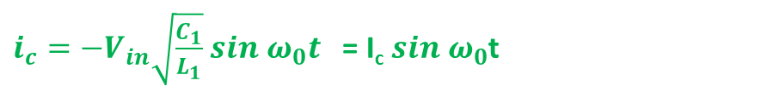
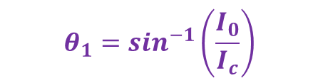
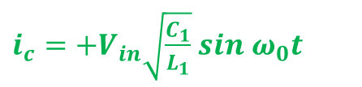
T_{A} is gated to turn off T₁
Mode 1
Both T₁ and T_{A} are on
C₁ discharges through T_{A} and L₁
$i_{c}=−V_{in}\sqrt{\frac{C_{1}}{L_{1}}}$ $sin ω_{0}t$ = I_{c} $sin ω_{0}$t
T_{A} is commutated when i_{c} = zero at ω₀t =π
+
V_{in}
_
c₁
T₁
i_{c}
D_{f}
Mode 2
L₁
i_{c} reverses and flows through L₁, D_{s} and load
D_{s}
i_{o}
i_{T1} decreases as i_{c} increases
T_{A}
+
V_{o}
_
When i_{c} is equal to i_{0 ,} i_{T1} decreases to zero.
T₁ becomes off
D₁
Load
$i_{c}=+V_{in}\sqrt{\frac{C_{1}}{L_{1}}}$ $sin ω_{0}t$
$$θ_{1}=\sin^{−1}\left(\frac{I_{0}}{I_{c}}\right)$$
T₁ remains reverse biased when D_{f} conducts
Turn off time of T₁ must be less than (π-2θ₁) $\sqrt{L_{1}C}1$

Slide 9
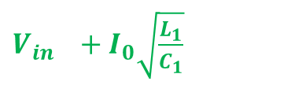
Mode 3
D_{f}, T₁ and T_{A} are off
Constant current i₀ flows through C₁, L₁, D_{s} and load
+
V_{in}
_
c₁
T₁
i_{c}
D_{f}
C₁ gets charged to V_{in}
L₁
Mode 4
D_{s}
i_{o}
T_{A}
+
V_{o}
_
Voltage across D₁ is zero. D₁ conducts and v₀ is zero
Load
D₁
i_{c} decreases to zero as I₀ cos ω₀t
v_{c} rises to
$V_{in }+I_{0}\sqrt{\frac{L_{1}}{C_{1}}}$

Slide 10
A large value of R_{f} is connected to reduce the voltage across C₁ to V_{in}
+
V_{in}
_
c₁
T₁
i_{c}
D_{f}
L₁
D_{s}
i_{o}
T_{A}
+
V_{o}
_
R_{f}
Load
D₁

Slide 11

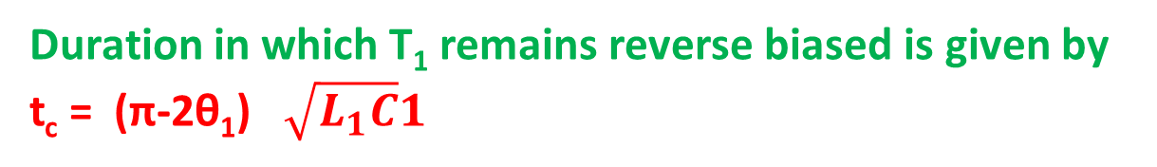
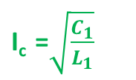

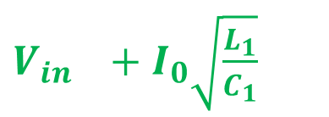
Duration in which T₁ remains reverse biased is given by t_{c} = (π-2θ₁) $\sqrt{L_{1}C}1$
$$θ_{1}=\sin^{−1}\left(\frac{I_{0}}{I_{c}}\right)$$
+
V_{in}
_
c₁
T₁
i_{c}
D_{f}
For given values of L₁, C₁, V_{in} and device turn off time t_{q}, there is a limit on the magnitude of load current I₀ for successful commutation
L₁
D_{s}
i_{o}
T_{A}
+
V_{o}
_
R_{f}
Load
D₁
Maximum voltage that comes across T₁ and T_{A} is the voltage across C₁
Peak current rating of T₁
is
$$\text{I}\text{0}$$
voltage rating of both T₁ and T_{A} is
$V_{in }+I_{0}\sqrt{\frac{L_{1}}{C_{1}}}$
Peak current rating of T_{A} is
$\text{I}\text{c} \text{=}\sqrt{\frac{C_{1}}{L_{1}}}$

Slide 12
2. Type A Chopper with voltage commutated Thyristor
T₁ is the main Thyristor
+
V_{in}
i_{c}
+
V_{c}
_
Energy for commutation is stored in the capacitor and inductor
c₁
T₁
L₁
T₁ is commutated when the auxiliary Thyristor T_{A} is turned on
T_{A}
D_{s}
i_{o}
+
V_{o}
_
D₁
Load
Initial Condition
T₁ is on
C₁ is charged to -V_{in}
T_{A} is gated to turn off T₁

Slide 13
Mode 1
T_{A} is gated to turn off T₁
+
V_{in}
i_{c}
T₁ is instantaneously turned off
+
V_{c}
_
c₁
Load current flows through C₁ and T_{A}
T₁
L₁
T_{A}
V_{c1} changes linearly from –V_{in} to +V_{in}
D_{s}
i_{o}
+
V_{o}
_
V₀ jumps to 2V_{in} and decreases to 0
D₁
Load
Duration of mode 1 is t₁ =
2V_{in}C/I₀
Turn off time t_{q} of T₁ must be less than
t₁/2 = V_{in}C₁/I₀
At the end of this mode V_{D1} is zero

Slide 14


Mode 2
D₁ is on
+
V_{in}
i₀ is I₀
i_{c}
V₀ is zero
+
V_{c}
_
c₁
Mode 3
T₁
This mode begins when T₁ is gated
L₁
C₁ discharges through T₁ , D_{s} and L₁
T_{A}
D_{s}
i_{o}
V_{c1} changes sinusoidally from +V_{in} to - V_{in}
+
V_{o}
_
D₁
Load
Duration of mode 3 is t₃
$t_{3 }=π\sqrt{{L_{1}C}_{1}}$
Turn off time for T_{A} is t₃/2
Peak current through T₁
$=I_{0}+V_{in}\sqrt{\frac{L_{1}}{C_{1}}}$

Slide 15





t_{q1} = V_{in}C₁/I₀
$t_{qA }=\frac{π}{2}\sqrt{{L_{1}C}_{1}}$
+
V_{in}
i_{c}
+
V_{c}
_
c₁
I₀t_{q1} / V_{in}
C₁ =
T₁
L₁
L₁ =
$${\left({\frac{2}{π}t}_{qA }\right)}^{2}{/C_{1}}^{ }$$
T_{A}
D_{s}
i_{o}
+
V_{o}
_
Load
Peak current through T₁ is
D₁
$=I_{0}+V_{in}\sqrt{\frac{L_{1}}{C_{1}}}$
Peak current through T_{A} is
$V_{in}\sqrt{\frac{L_{1}}{C_{1}}}$
Peak voltage across D₁ is
$${2V}_{in}$$

